Slide 1
FOMC Project Data Review
Ugh

Slide 2
Prices
Shock Data
2000 – 2007
GDP Price Deflator (non-core)
2007 – Current
Core PCE
We had to do this because Philly Fed:
Has tracked GDP Prices since its inception
Started collecting forecasts for core PCE in 2007
Historical data are percent change from one year ago
Forecast data are annualized expected quarterly percent change
Taylor Data
Core PCE is the annual average of quarterly percent change

Slide 3
Prices
corecpi = annual averages of monthly data
corepce = annual averages of monthly data
p = yoy % change of quarterly data (GDP price through 2007)

Slide 4
Prices
GDP Price
Core PCE

Slide 5
Growth
Shock & Taylor use Real GDP
Historical data are percent change from one year ago.
Forecast data are annualized expected percent change
Taylor needs a trend for output gap
CBO data is slow to react
Calculated a log-linear trend starting in 1959
Also tried 1980, 1995
1995 has better coefficient (lower) but far-lower t-stats

Slide 6
Growth

Slide 7
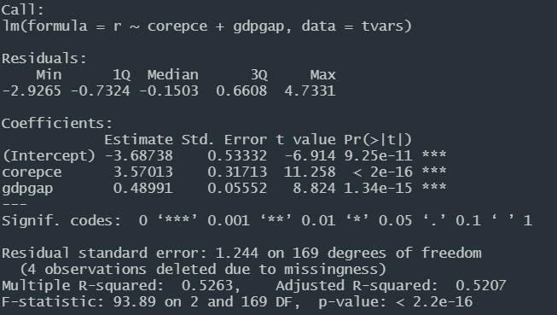
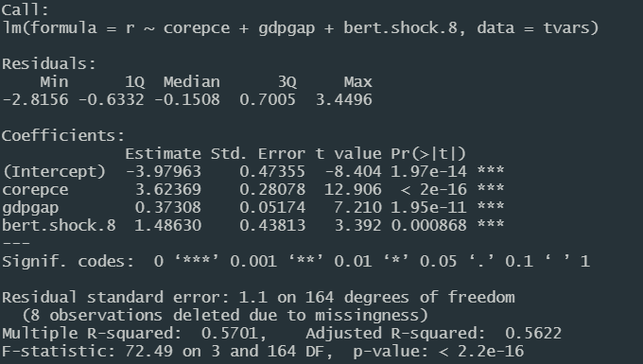
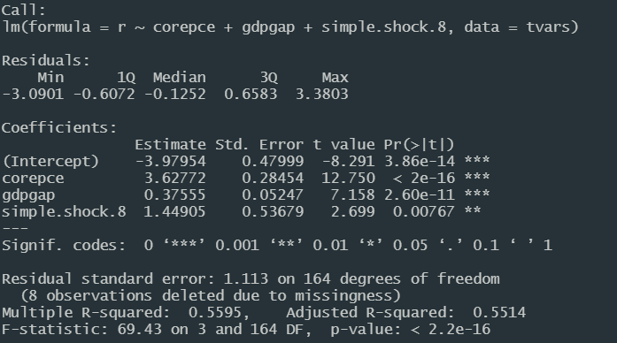
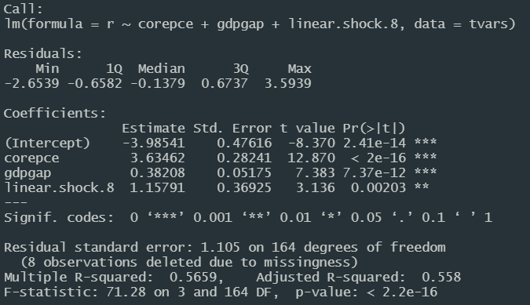
New Output

